Slide 1
WHONET Training Course
Module 6 – Quick analysis reports
Division of Infectious Diseases, Brigham and Women’s Hospital, Boston, United States
WHO Collaborating Centre for Surveillance of Antimicrobial Resistance

Slide 2
Module 6. Data analysis – Quick analysis
6
A
Introduction to Quick analysis
B
WHONET Standard reports – Screen and Excel
C
WHONET Standard reports – Word
D
User-defined reports
E
DHIS2 – Brief introduction
F
WHONET Automation Tool – Brief introduction

Slide 3
6
Benefits of WHONET reports
In WHONET Quick analysis, the data analyst can create automatic “reports”, which combine the results of several analyses into a single output.
Reports can be shared with partners in the laboratory, pharmacy, infectious diseases, infection control, national authorities, collaborating organizations, and funders.
Like WHONET macros, reports save time and promote consistency with repeated analyses.
One WHONET user can create reports for many other WHONET users, which promotes standardization and collaborative discussions of results both within a single institution and across many institutions.
WHONET reports can be automated to run on a periodic basis (daily, weekly, monthly, etc.)

Slide 4
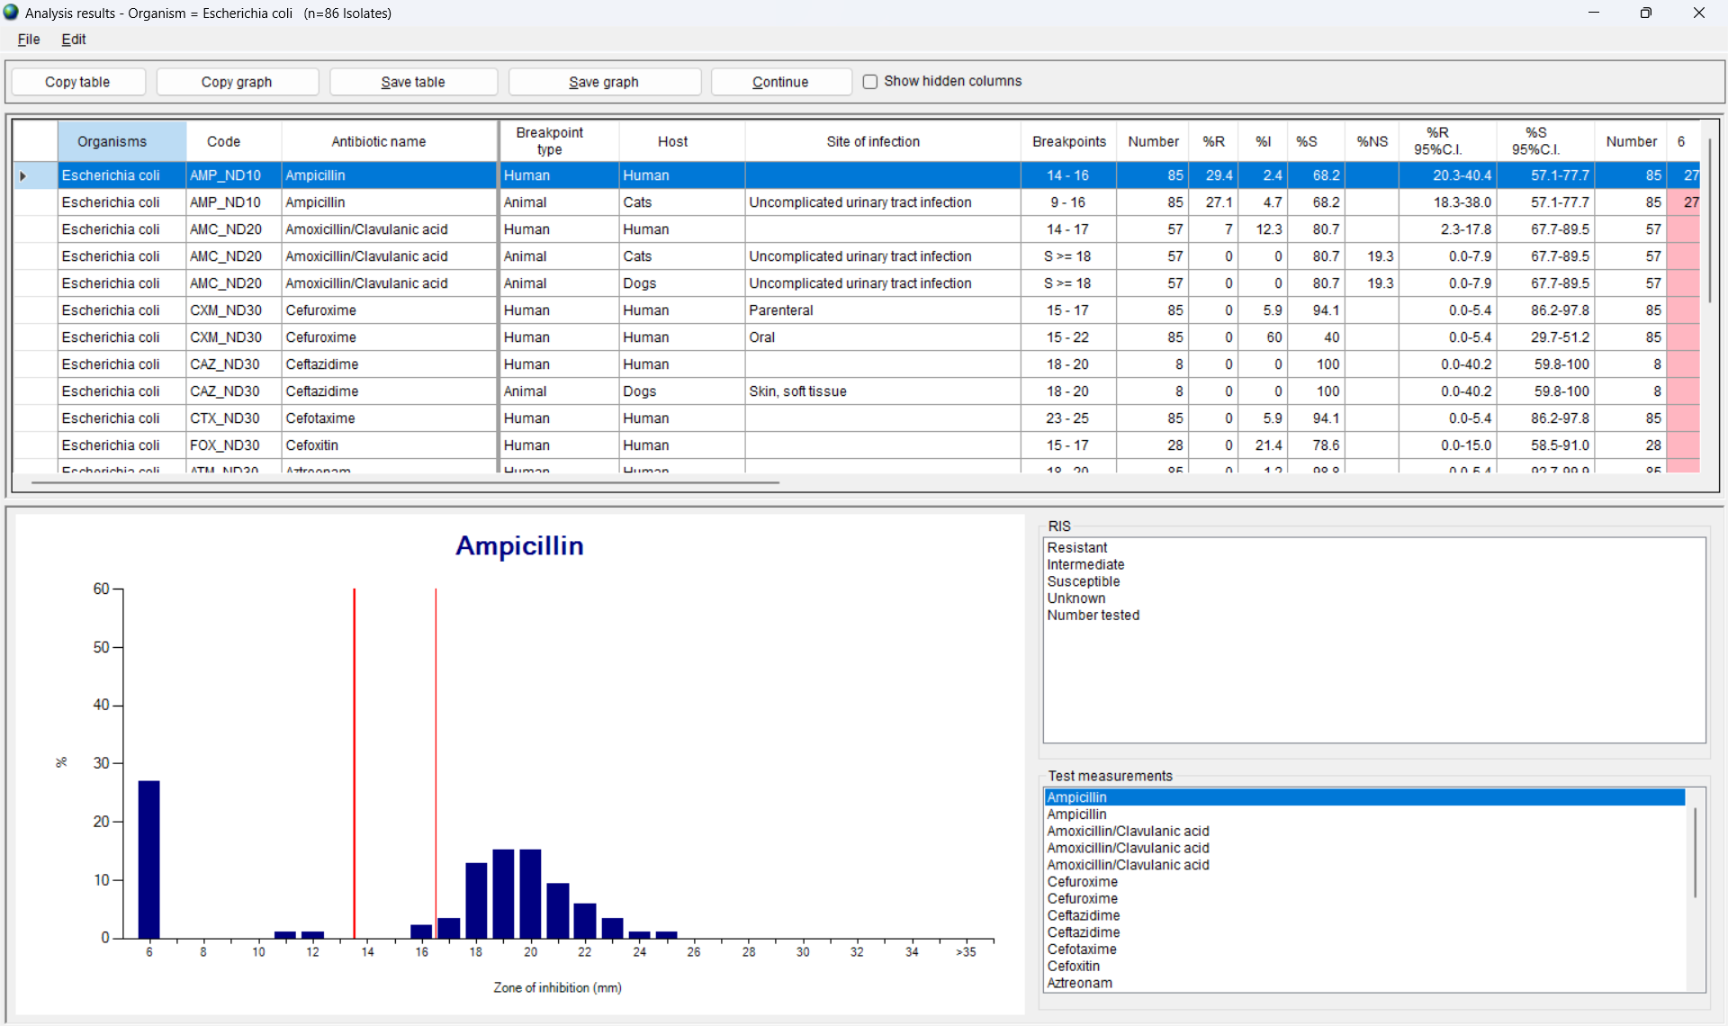
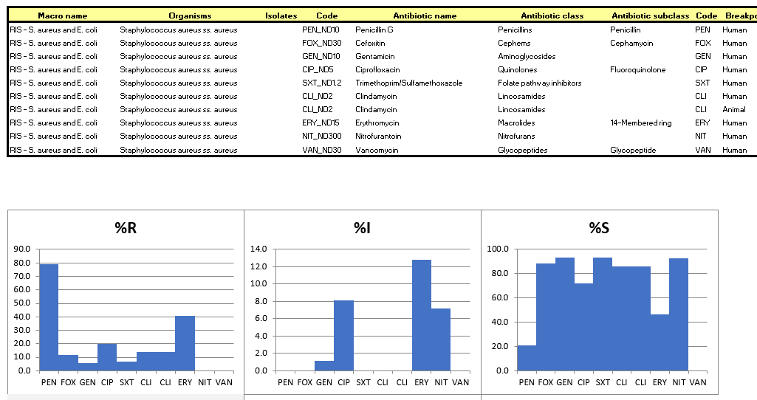
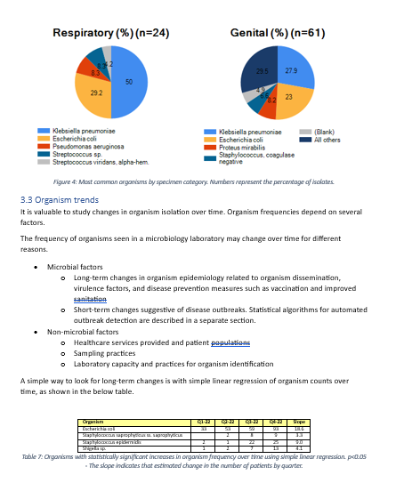
Output options
6
Screen
Excel
Word

Slide 5
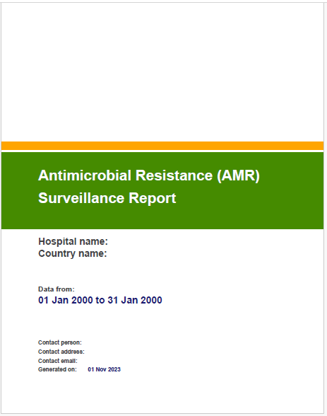
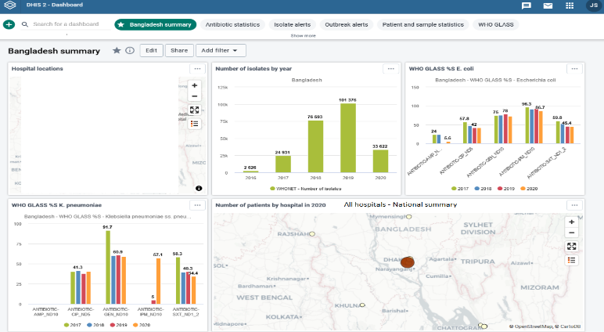
Interoperability with other systems
6
PDF (AMASS)
DHIS2
www.amass.website
www.dhis2.org

Slide 6
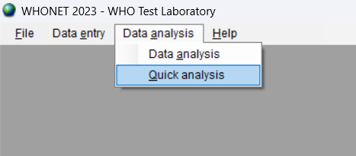
Open laboratory and choose Quick analysis
6
B

Slide 7
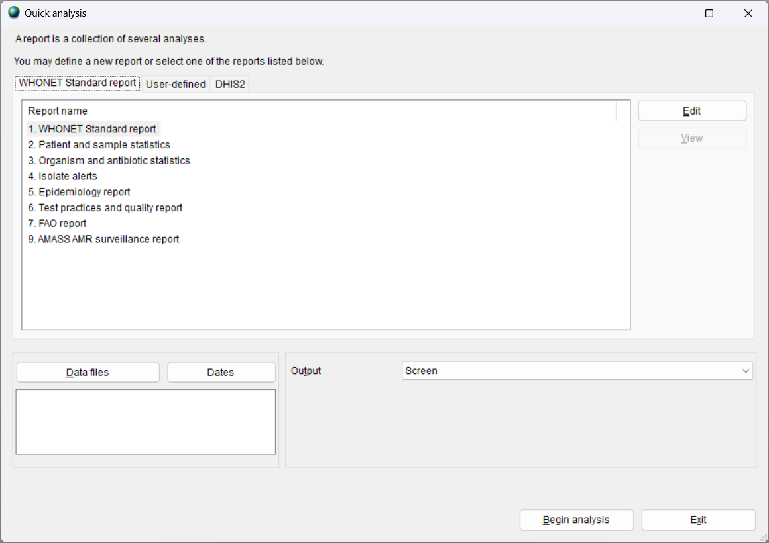
6
Quick analysis – report types
WHONET Standard reports
Screen, Excel, Word, and PDF
User-defined reports
Screen and Excel
DHIS2
DHIS2 “Data Set” files
DHIS2 “Meta-data” files

Slide 8
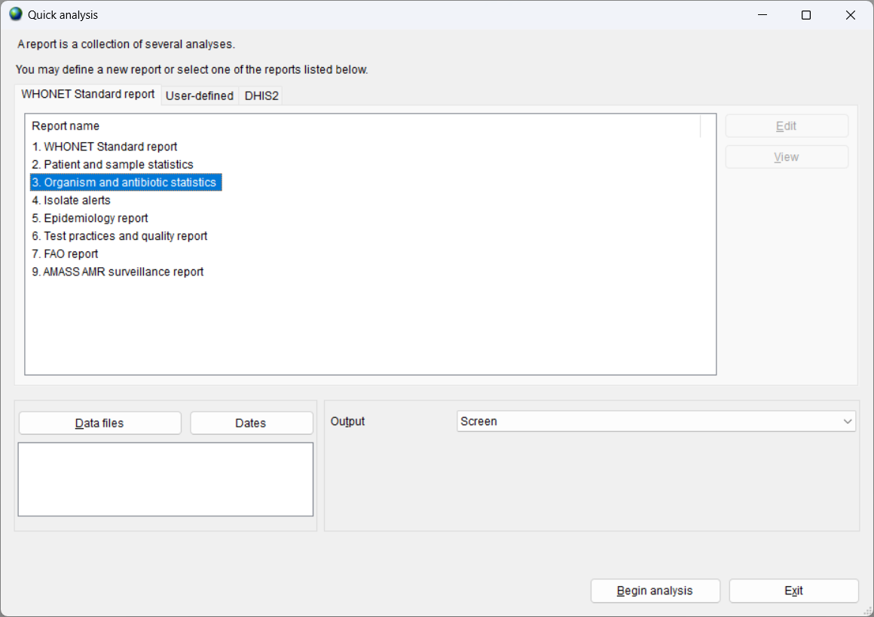
6
Quick analysis parameters
Choose a report
Choose a data file or many data files
Choose the output destination
Screen, Excel, Word, or PDF
The valid choices will depend on which report you select

Slide 9
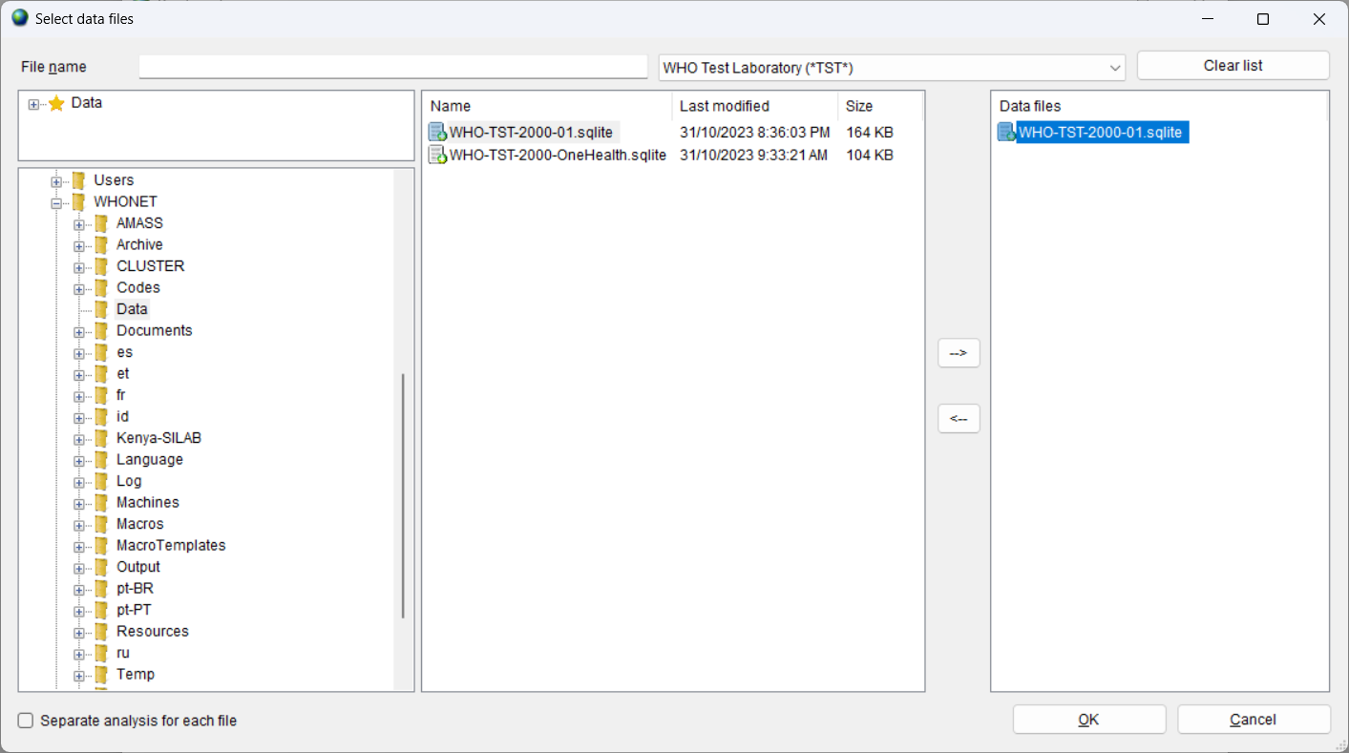
Choose the data files
6
B
Choose one or more data files
The data files can be from one laboratory or from many laboratories

Slide 10
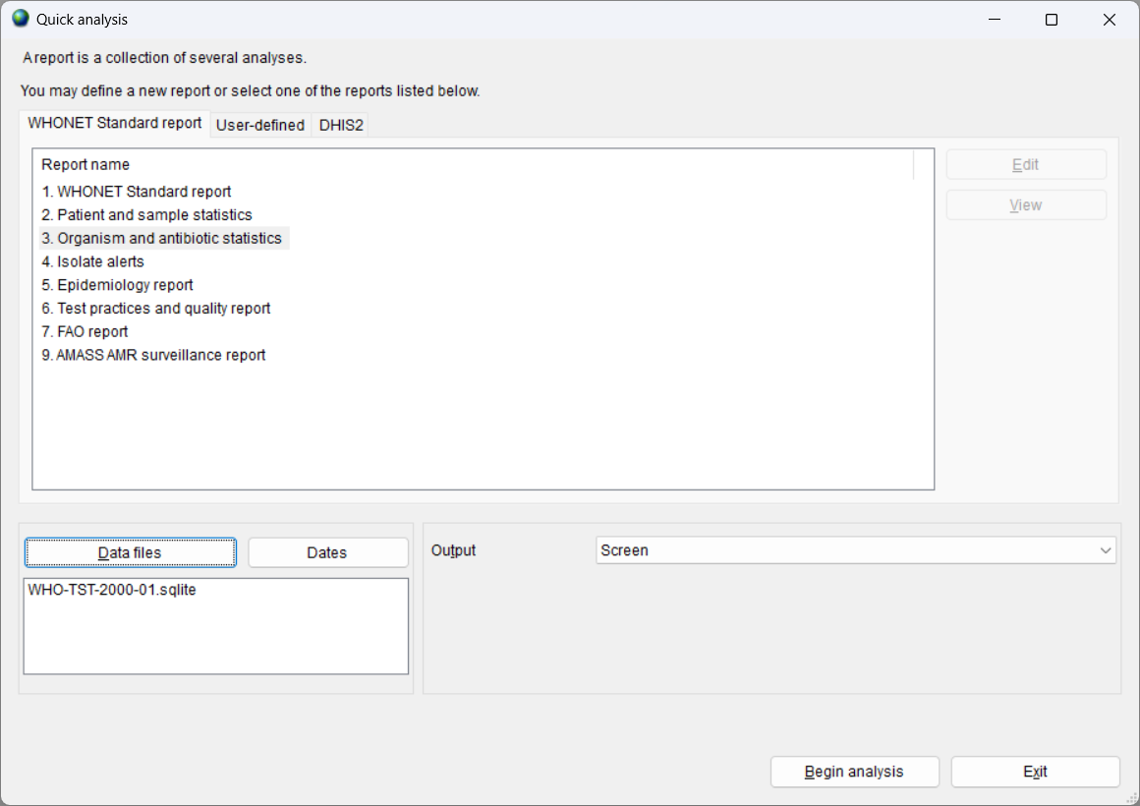
6
The data file is selected

Slide 11
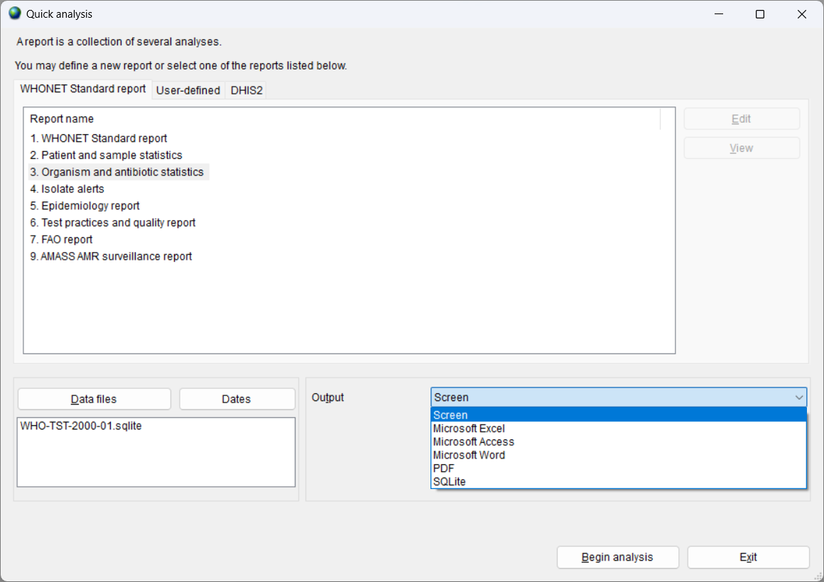
6
Quick analysis – Output options
The specific output options will depend on which report you choose.
Some reports were developed for the screen and Excel, while other reports were developed for Word, PDF, or DHIS2.

Slide 12
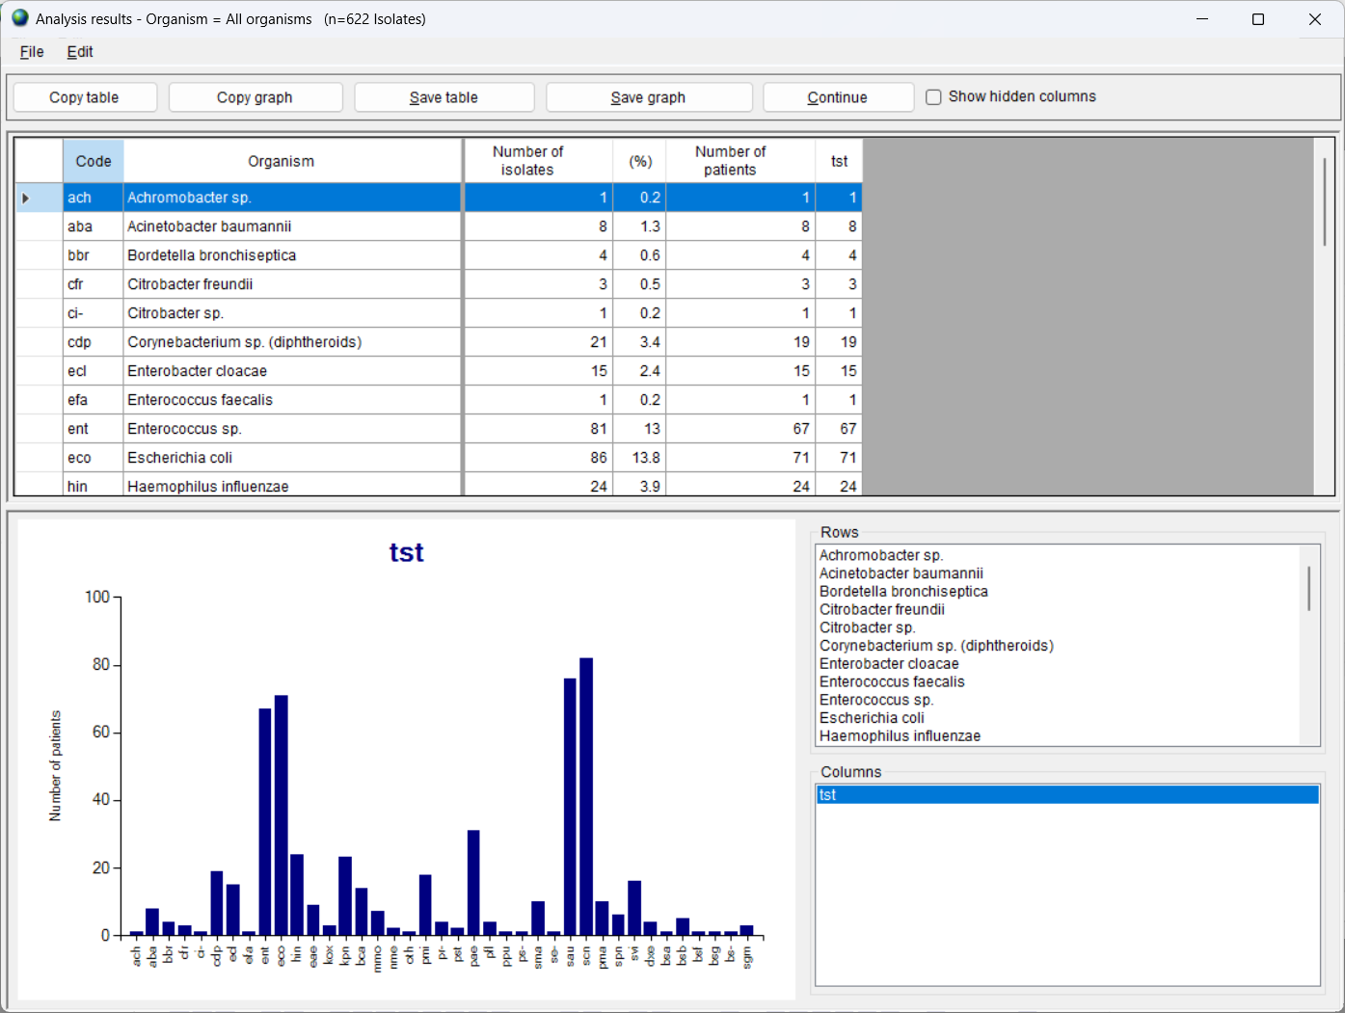
6
Organism and antibiotic statistics
Organism by laboratory
Review the results
Choose the graphs
Copy or save the results
Click on “Continue” when finished to proceed with the next analysis in the report

Slide 13
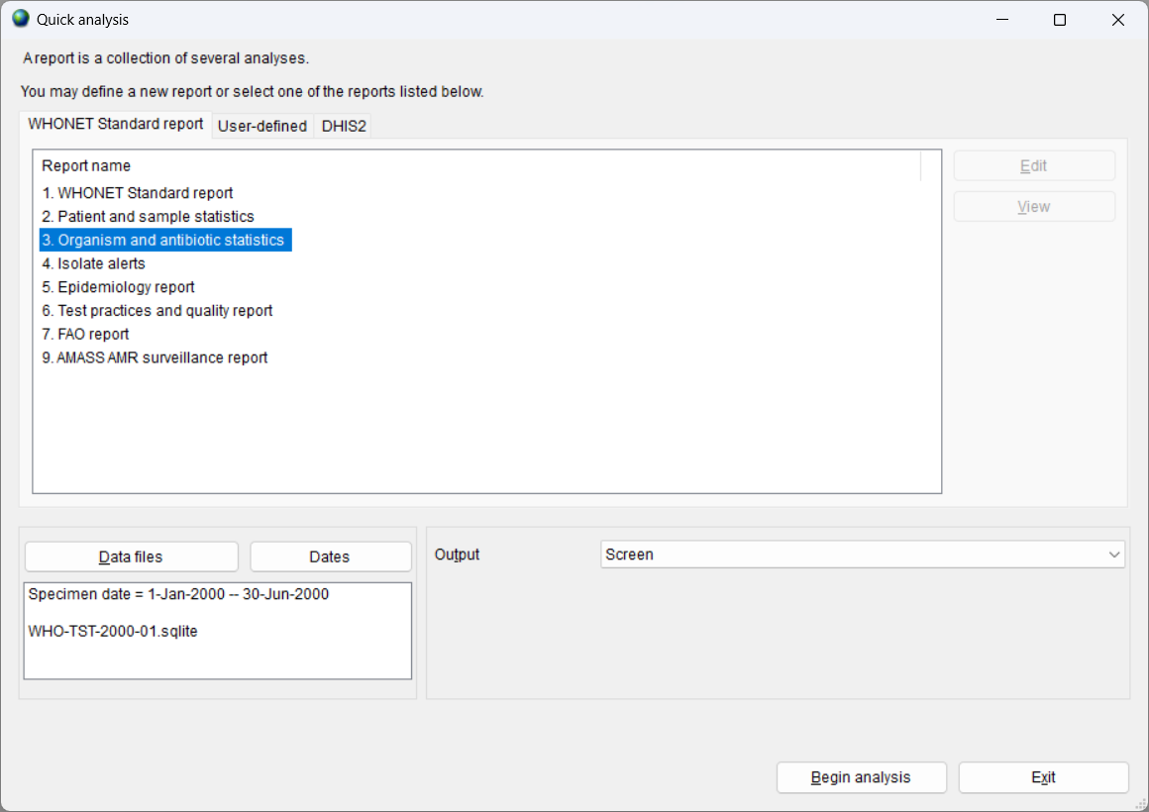
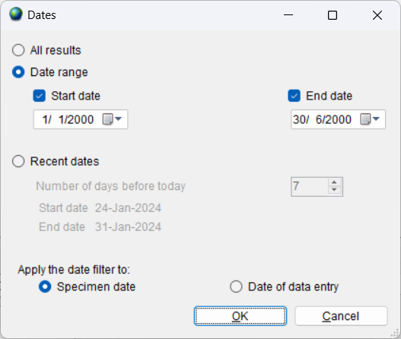
6
Including a date filter
This feature is useful if you are only interested in a subset of dates.
It is also useful to filter out incorrect specimen dates such as “January 1, 1990” or “March 20, 2050”.

Slide 14
6
Module 6. Data analysis – Quick analysis
A
Introduction to Quick analysis
B
WHONET Standard reports – Screen and Excel
C
WHONET Standard reports – Word
D
User-defined reports
E
DHIS2 – Brief introduction
F
WHONET Automation Tool – Brief introduction

Slide 15
6
WHONET Standard reports
Screen and Excel
Screen and Excel
2. Patient and sample statistics
3. Organism and antibiotic statistics
4. Isolate alerts

Slide 16
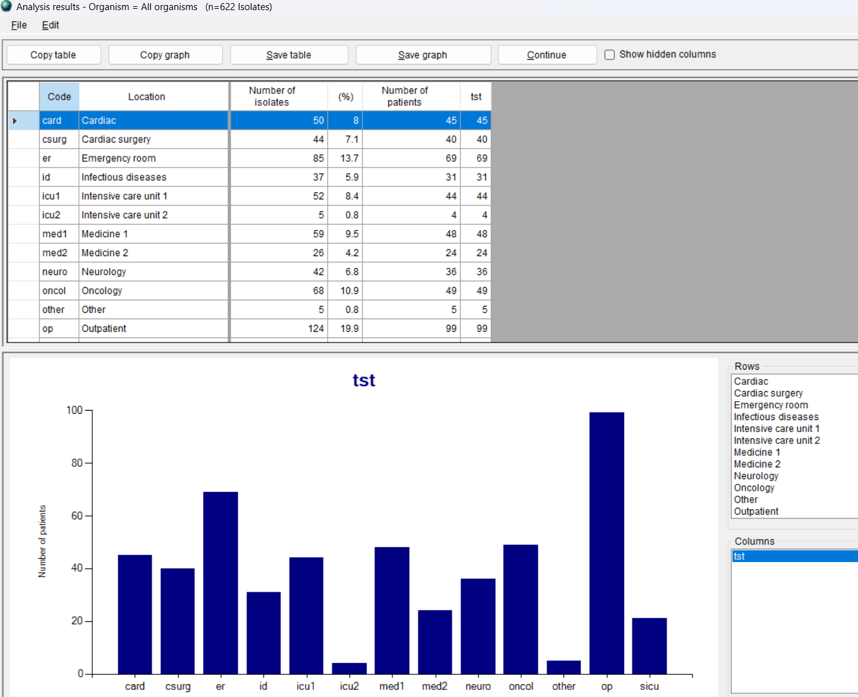
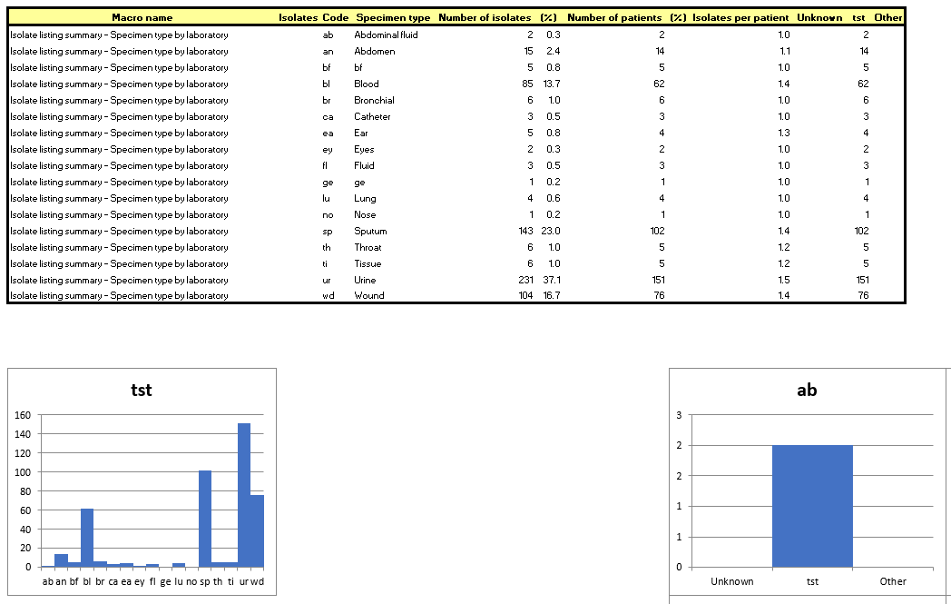
6
WHONET Standard report
- Patient and sample statistics
Locations (Screen)
Analyses
Laboratory by specimen month
Sex by laboratory
Age group by laboratory
Location by laboratory
Location type by laboratory
Specimen type by laboratory
Specimen types (Excel)

Slide 17
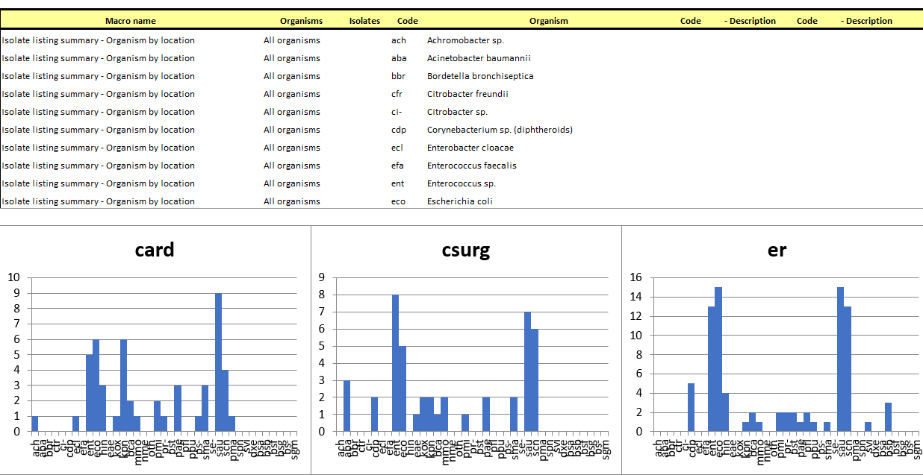
WHONET Standard report
- Organism and antibiotic statistics
6
Organism by location (Excel)
Organism
Organism by laboratory
Organism by specimen month
Organism by sex
Organism by age group
Organism by location
Organism by location type
Organism by specimen type
%RIS for Escherichia coli (Screen)
Antibiotics
%RIS for Staphylococcus aureus
%RIS for Escherichia coli
Gram-positive antibiogram
Gram-negative antibiogram

Slide 18
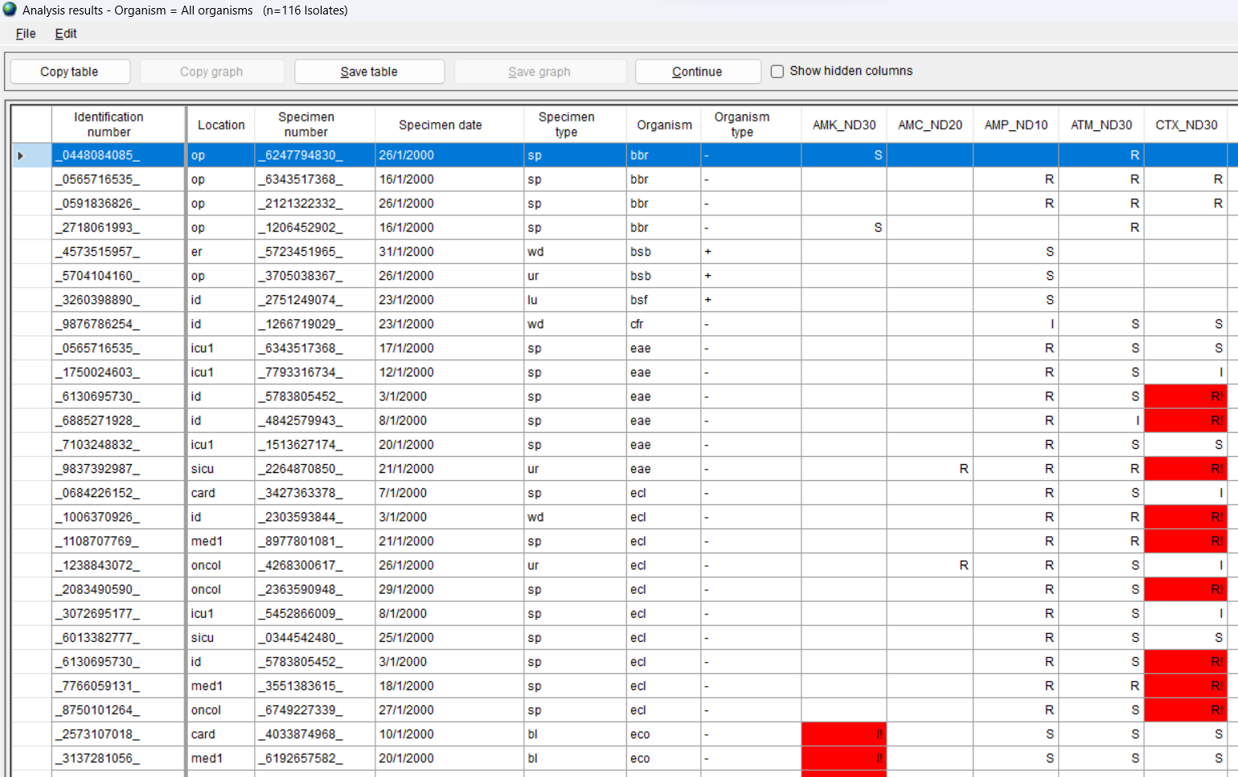
WHONET Standard report
- Isolate alerts
6
Isolate listing (Screen)
Alerts for important species and important resistance
Listing
Summary
Alerts for quality control
Listing
Summary
Summary (Excel)

Slide 19
6
Output: Screen and Excel reports
Advantages
A variety of distinct analyses with comprehensive details, such as all locations, all specimen types, all organisms, and all antibiotics.
On the screen, the output is interactive, so you can select any graph.
In Excel, the raw data are available if you would like to modify the output content or formatting.
Disadvantages
No explanatory text is provided.
The extra details are of great value to the primary data analysts but can be overwhelming and unneeded by colleagues and other stakeholders, who would often prefer a shorter presentation which highlights and discusses priority findings and conclusions.
The format for Excel tables and graphs is not convenient for printouts that can be shared with others.

Slide 20
6
Module 6. Data analysis – Quick analysis
A
Introduction to Quick analysis
B
WHONET Standard reports – Screen and Excel
C
WHONET Standard reports – Word
D
User-defined reports
E
DHIS2 – Brief introduction
F
WHONET Automation Tool – Brief introduction

Slide 21
6
WHONET Standard reports
Microsoft Word
Word
5. Epidemiology report
6. Test practices and quality report
7. FAO report (in development)

Slide 22
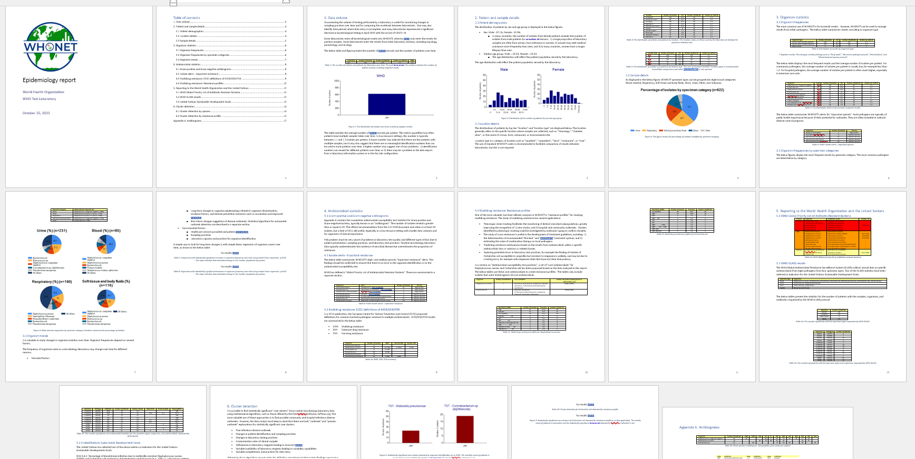
Epidemiology report
Full report
The document is a mixture of texts, graphs, and tables divided into different sections.
Most of the results can be generated through “Data analysis”.
Some of the analyses were created specially for this report.

Slide 23
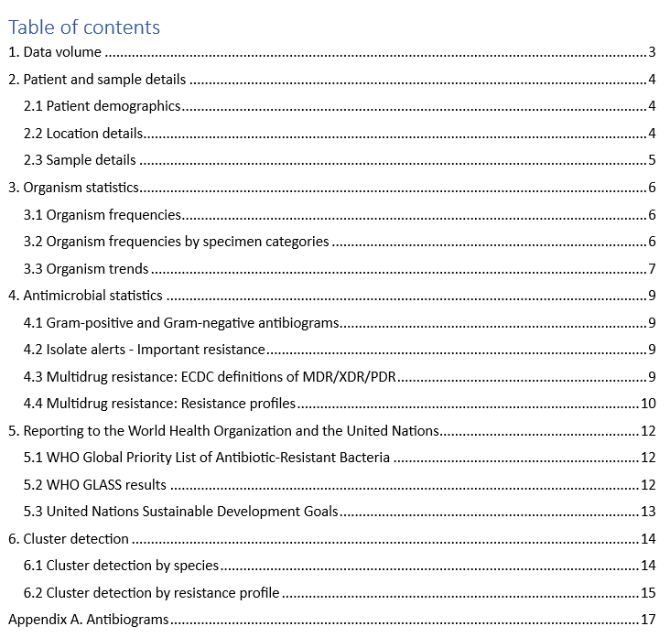
Epidemiology report
Title page and Table of contents
6

Slide 24
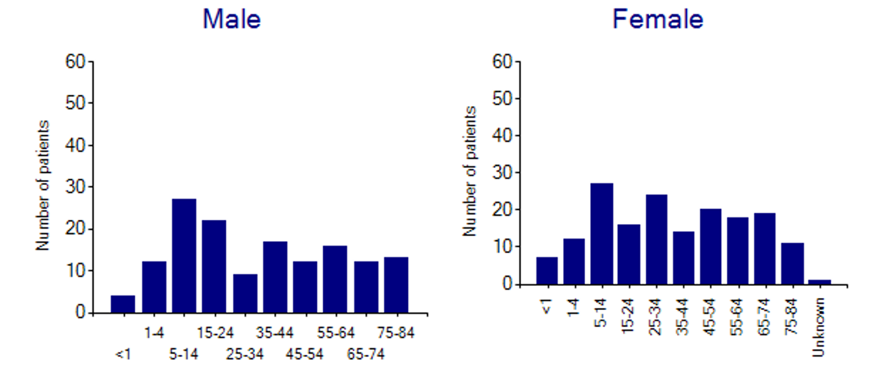
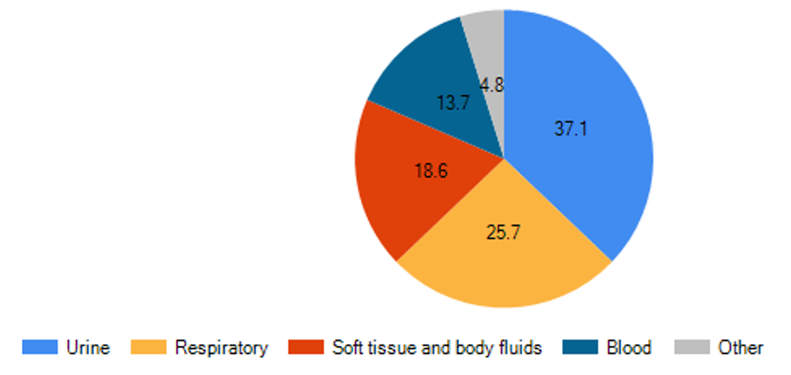
Epidemiology report
Section: Patients and samples
Analyses
By laboratory and by year
Age distributions by sex
Most common locations
Specimen categories
Figure 2. Age groups by sex
Figure 3. Specimen categories

Slide 25
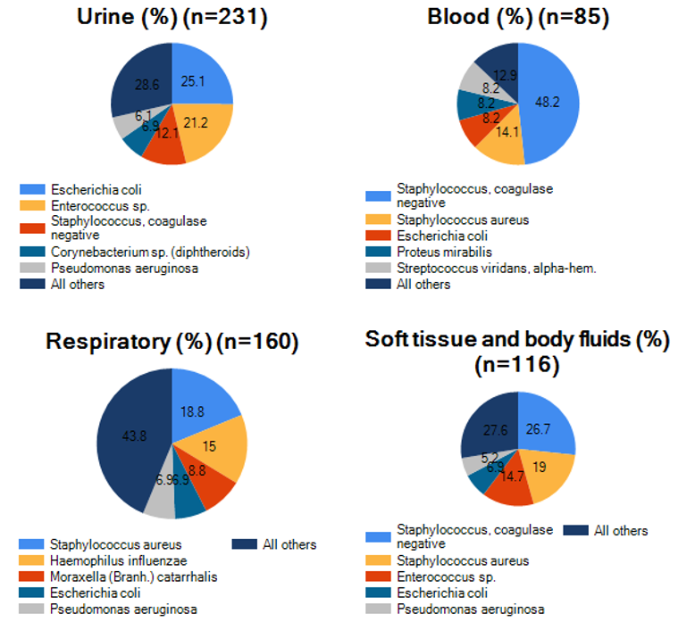
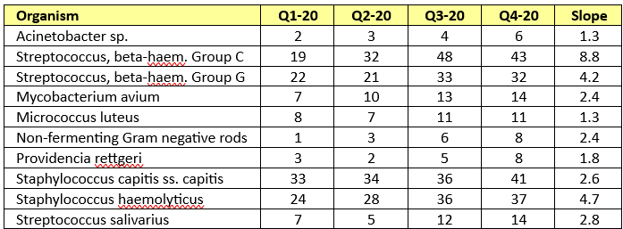
Epidemiology report
Section: Organisms
Analyses
By month
By specimen category
Important species
Trends over time
Figure 4. Organisms by specimen category
Table 7. Organisms increasing over time

Slide 26
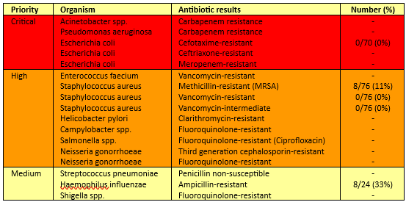
Epidemiology report
Section: Antibiotics
Analyses
Alerts for Important resistance
Antibiograms
WHO List of priority resistance
UN Sustainable Development Goals
Multidrug resistance
Table 13. WHO Priority resistance
Table 23. Gram-negative antibiogram

Slide 27
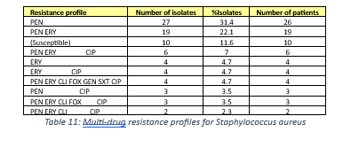
Epidemiology report
Section: Antibiotics and Multidrug resistance
Table 10. Multidrug resistance
ECDC definitions
Table 11. Multidrug resistance
WHONET resistance profiles

Slide 28
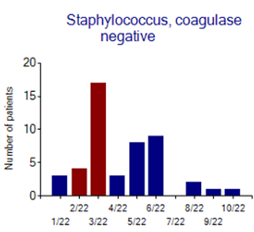
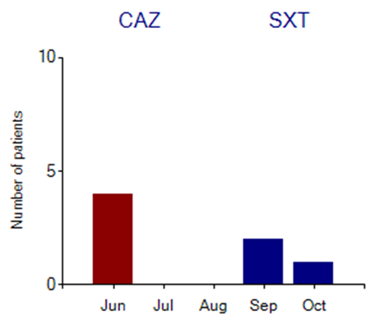
Epidemiology report
Section: Cluster detection
Figure 5. Cluster detection by species
Figure 6. Cluster detection by resistance profile

Slide 29
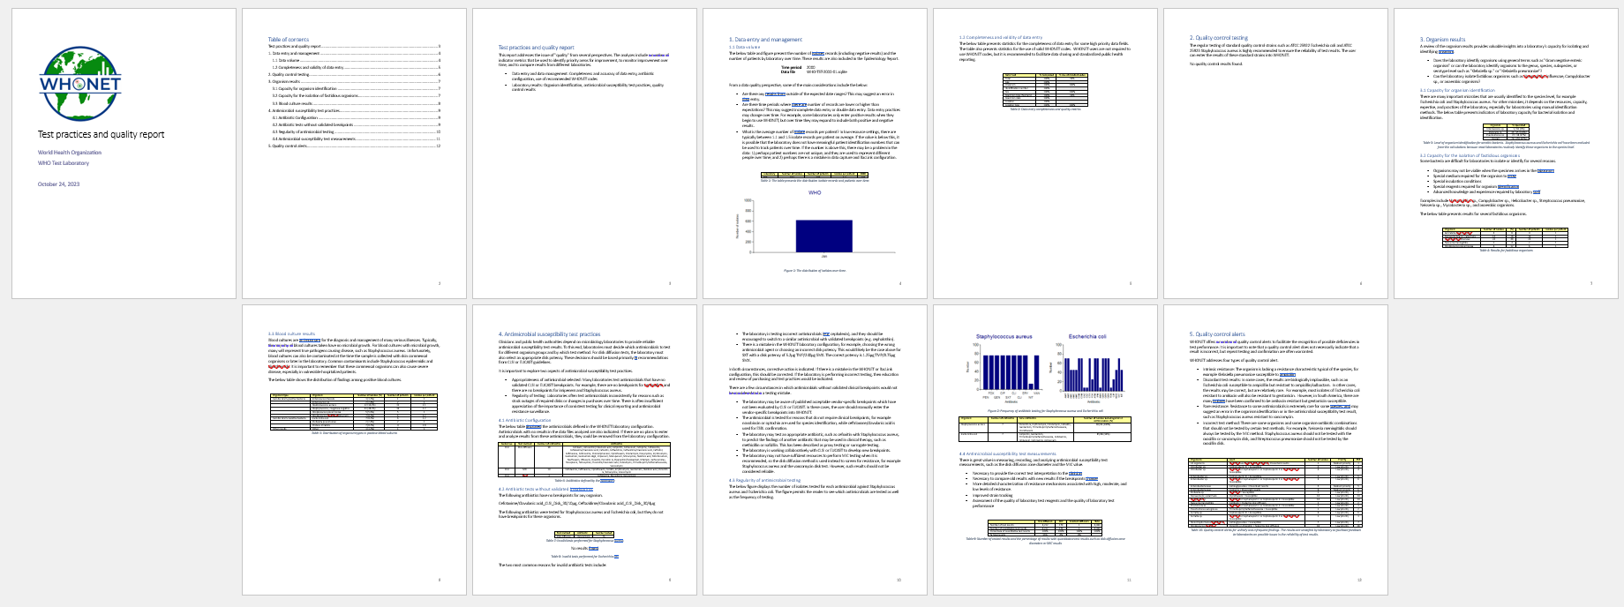
Test practices and data quality
Full report

Slide 30
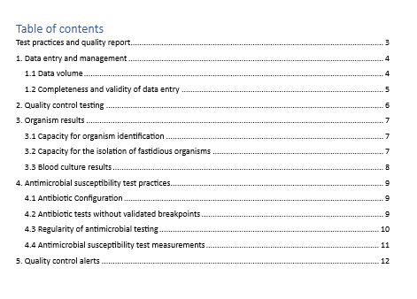
6
Test practices and data quality
Cover page and Table of contents

Slide 31
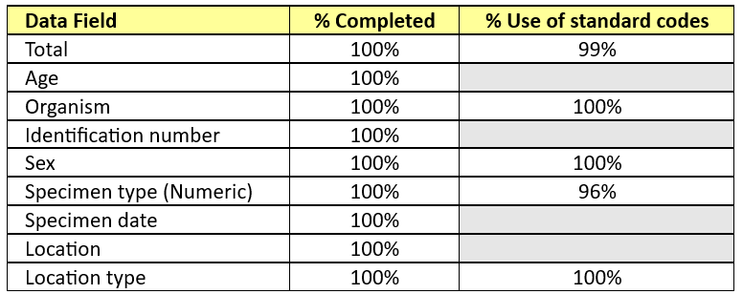
Test practices and data quality report
Section: Data completeness and validity
Table 2. Data completeness and validity

Slide 32
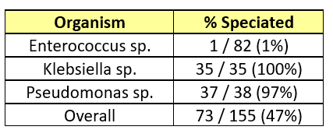
Test practices and data quality report
Section: Organisms
Table 3. Capacity for species identification
Table 4. Capacity for isolation of fastidious pathogens

Slide 33
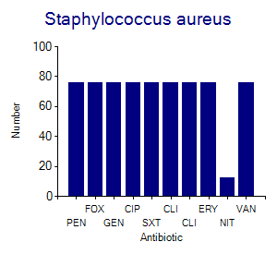
Test practices and data quality report
Section: Antimicrobial susceptibility testing
Table 7. Invalid tests for Staphylococcus aureus
Figure 2. Regularity of testing

Slide 34
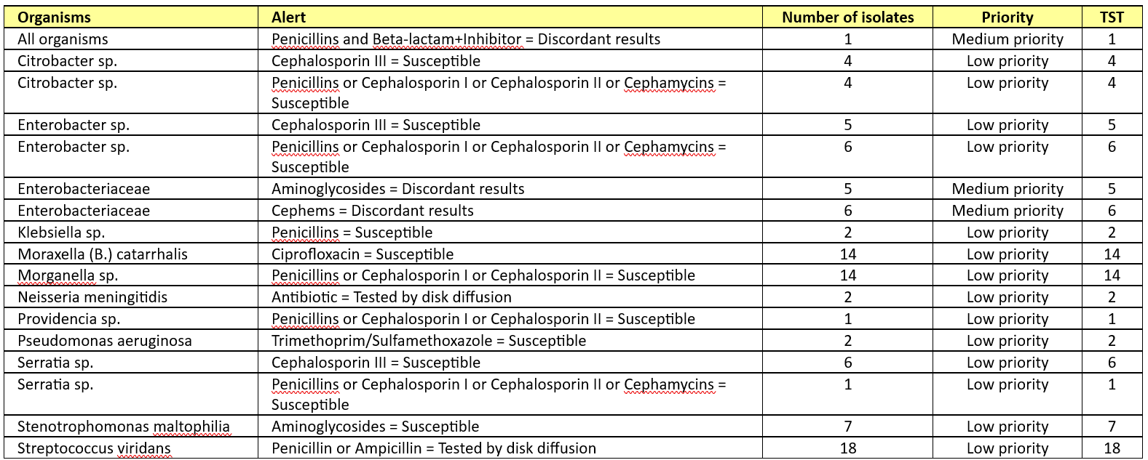
Test practices and data quality report
Section: Quality control alerts
Table 10. Infrequent and unlikely test results

Slide 35
6
Output: Microsoft Word
Advantages
The report focuses on the highest priority results, for example “Top 10 organisms” with a lot of explanatory text.
The report can easily be printed and shared with local, national, and international colleagues
Disadvantages
The focus is certain priority results defined by the WHONET team.
The content and formatting of the report is rigid, and cannot be edited by the user
In future versions of the report
We will include some ability to customize the report – logos, text, content, criteria, thresholds, etc.
We will start to include some automated “highlights” and “recommendations”.

Slide 36
Module 6. Data analysis – Quick analysis
6
Module 6. Data analysis – Quick analysis
A
Introduction to Quick analysis
B
WHONET Standard reports – Screen and Excel
C
WHONET Standard reports – Word
D
User-defined reports
E
DHIS2 – Brief introduction
F
WHONET Automation Tool – Brief introduction

Slide 37
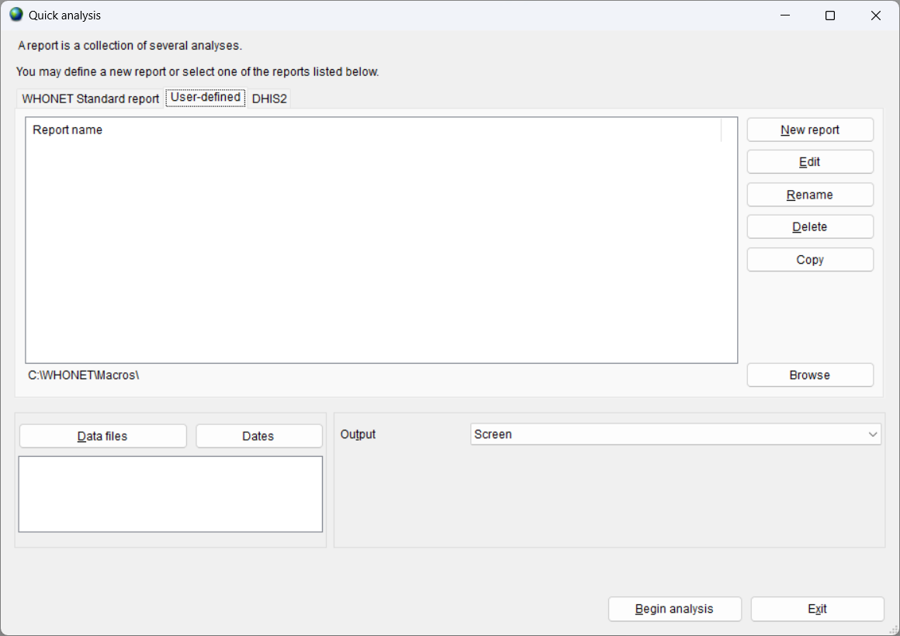
6
User-defined reports
When you begin with WHONET, there are no user-defined reports.
You can use “New report” to create reports. For example:
Daily, weekly, and monthly reports
Reports for the laboratory, pharmacy, and infection control team

Slide 38
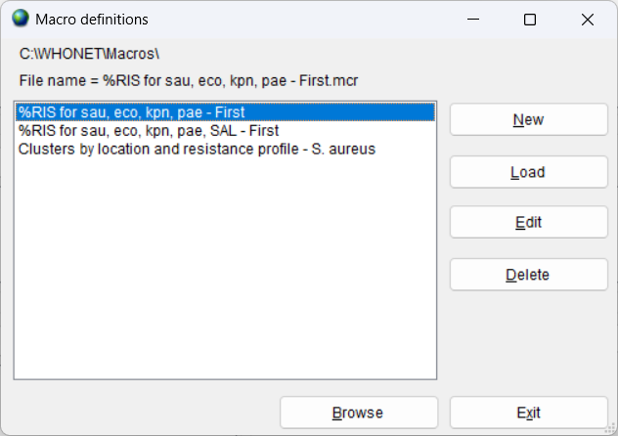
6
Before you create a new report
A user-defined report is a collection of macros that you have created.
Therefore, the first step is to go to “Data analysis” and create a series of macro.
The “Data analysis” training module provided steps for creating three macros:
Gram-positive antibiogram
Gram-negative antibiogram
Gram-negative antibiogram in blood
(Screen grab needs to be updated)

Slide 39
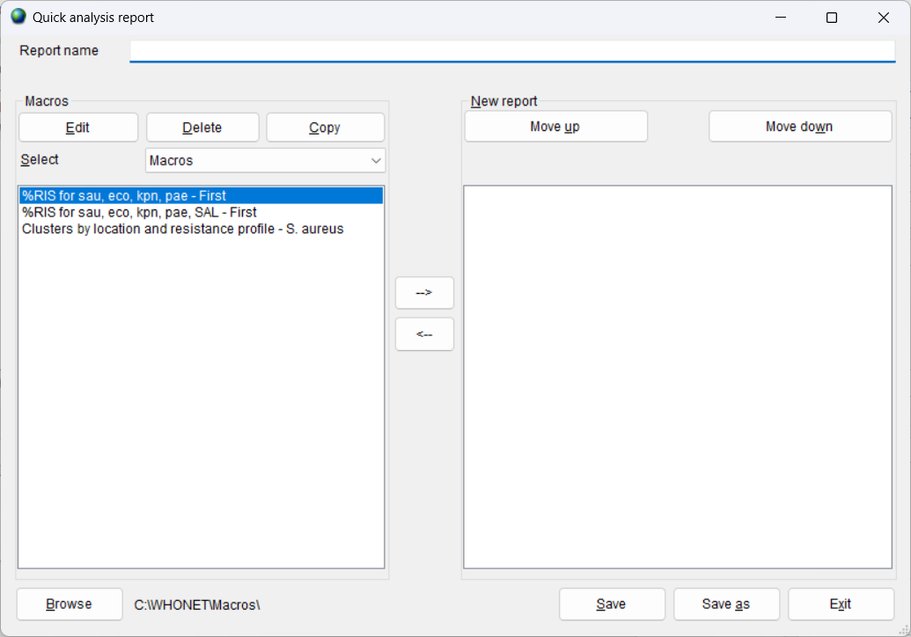
6
Creating a new report, Part 1
From “User-defined reports”, click on “New report to get the below screen.
Give a name to the new report, for example “Antibiogram report”.
On the left, you will see the list of macros that you have previously defined. (You can use “Browse” to change the folder.).
Choose the macros on the left that you would like to include in the report by double-clicking or by using the arrow buttons.

Slide 40
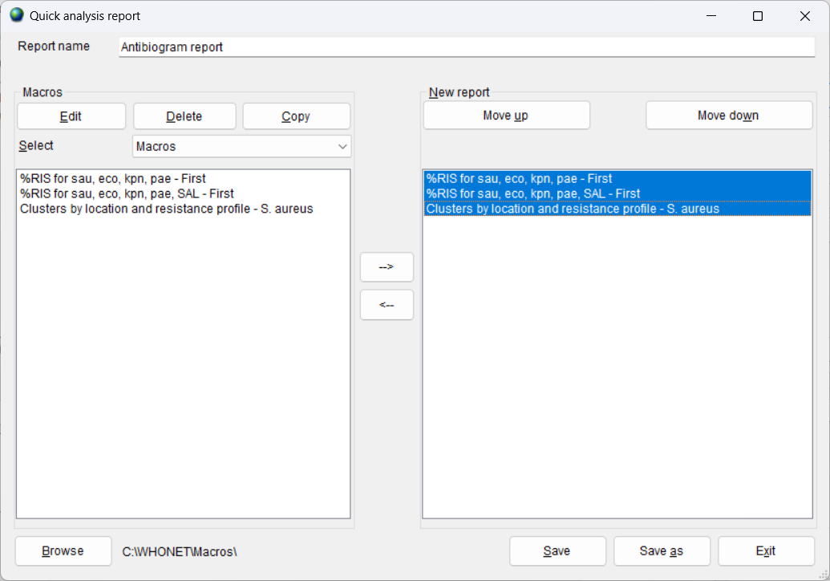
6
Creating a new report, Part 2
Give a name to the new report, for example “Antibiogram report”.
On the left, you will see the list of macros that you have previously defined. (You can use “Browse” to change the folder.).
Choose the macros on the left that you would like to include in the report by double-clicking or by using the arrow buttons.
You can use “Move up” and “Move down” to change the sequence of the macros.”
Click on “Save” when you are finished to same the report name: “Antibiogram report”.
Click on “Save” again to save the report file: “Antibiogram report.rpt”
Then click on Exit to close the screen.

Slide 41
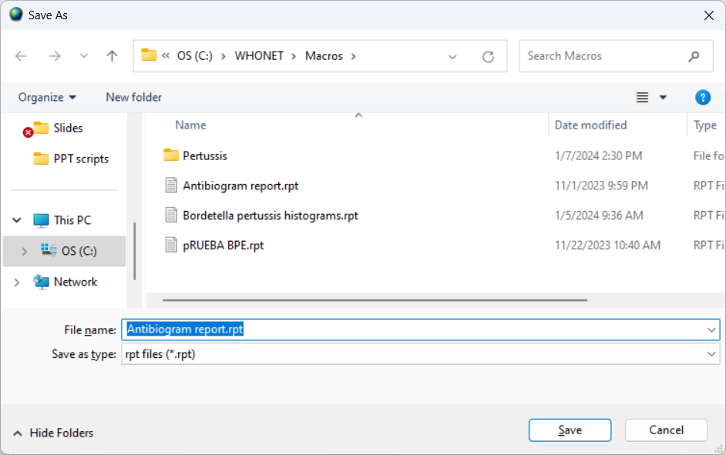
6
Save the report
The name of the report is “Antibiogram report”
For the report file, WHONET suggests the name “Antibiogram report.rpt” saved in the C:\WHONET\Macros folder.
You can change the default name and location if you would like.
When finished, click on “Save”.

Slide 42
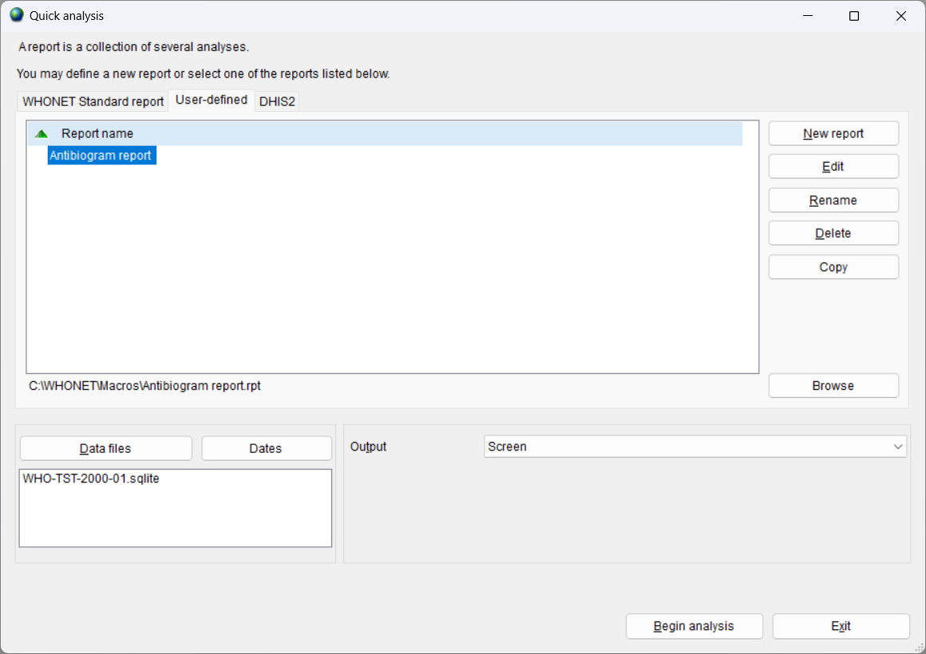
6
Using a report – Results to the screen
Select the report
Choose your data file or your data files
Choose “Screen”
Choose “Begin analysis”
WHONET will then show the results of the macros on the screen.
Other options include “Edit”, “Rename”, “Delete”, and “Copy”

Slide 43
6
Report results on the screen
Click “Continue” to advance to the next macro. Or you can click on “File”, “Stop analysis” to end the analysis immediately.

Slide 44
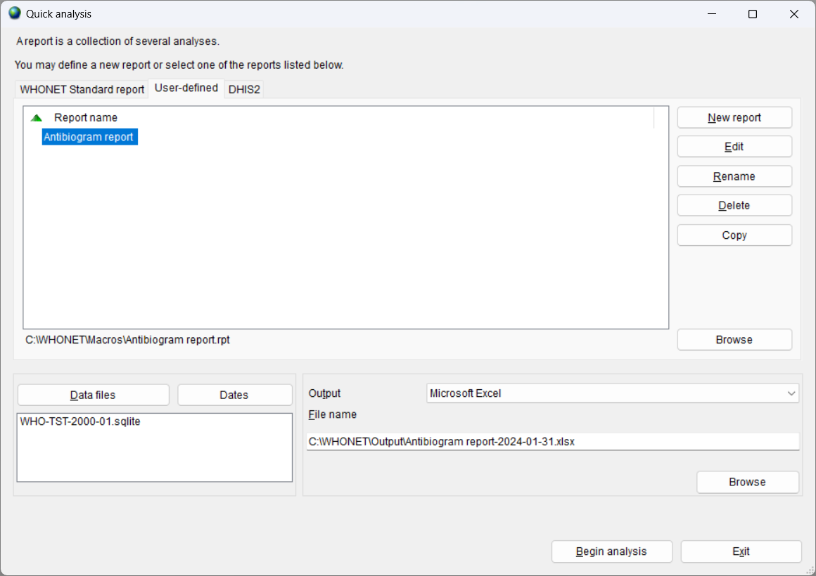
6
Using a report – Results to Excel
Select the report
Choose your data file or your data files
Choose “Excel”
WHONET will suggest a file name of the new Excel file including the name of the macro and the current date
Choose “Begin analysis”

Slide 45
6
Report results in Excel
When WHONET finishes the analysis, it will ask you if you want to open the report. Select “Yes”. If you do not see your report immediately, then click on the Excel icon at the bottom of the screen.
The name of the Excel file will include the name of the report and the date of the analysis, for example “Antibiogram report.2020-01-01.xlsx”. The default location is C:\WHONET\Output.
There will be one Excel sheet for each analysis.

Slide 46
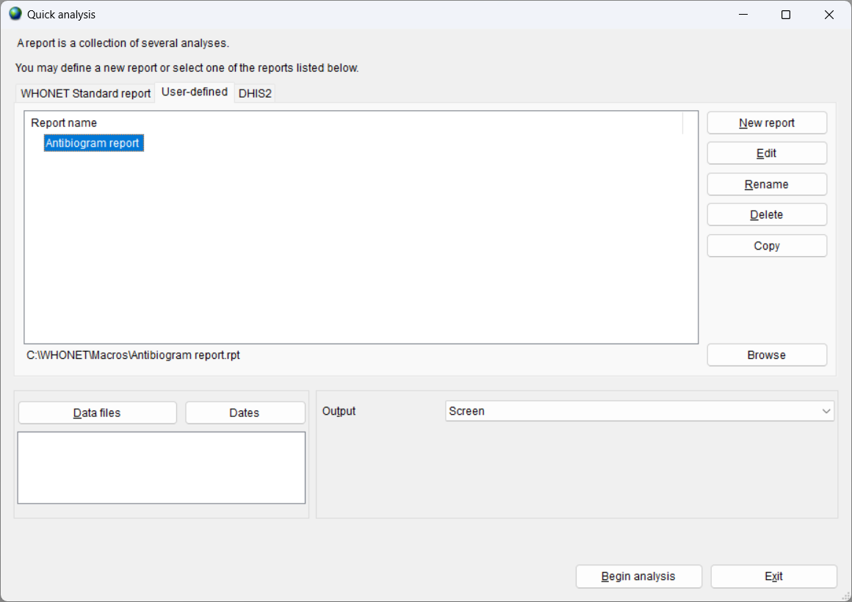
Editing a report using WHONET
Go to Quick analysis, and click on “User-defined”.
You will see a list of all of the reports. Choose the report that you are interested in. Click on “Edit”.
You will then see the macros that are defined for the report. You can add, remove, or reorder the macros. A report may also include subreports. When you finish, click “Save” or “Save as” and “Exit”.

Slide 47
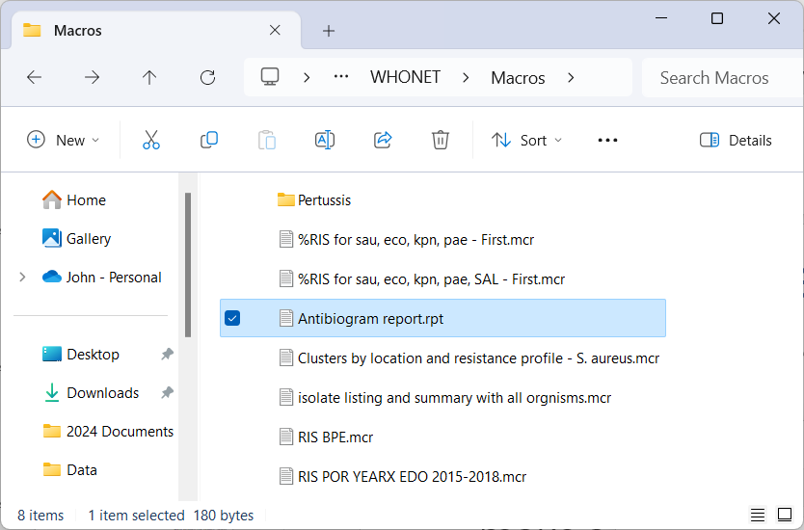
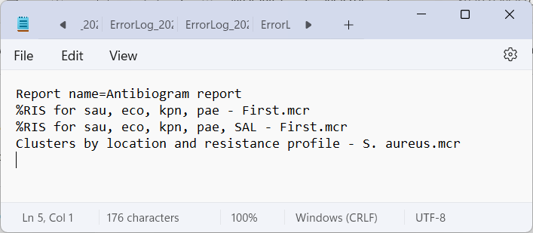
Editing a report using NotePad
Reports are simple text files and can be edited with any text editor, such as NotePad.
By default, WHONET reports are saved in C:\WHONET\Macros.
Find the report that you wish to edit. You can edit this file, or you can make a copy and edit the copy.
The report file indicates the names of the macros that are included in the report.
Windows File Explorer
NotePad

Slide 48
How to share or backup a report
By default, macro and report files are stored in the location C:\WHONET\Macros.
From here, you can make backup copies or send copies to your colleagues by email.
Reports only contain a list of macros and subreports. They have no confidential information in them, so can be freely shared with collaborators.

Slide 49
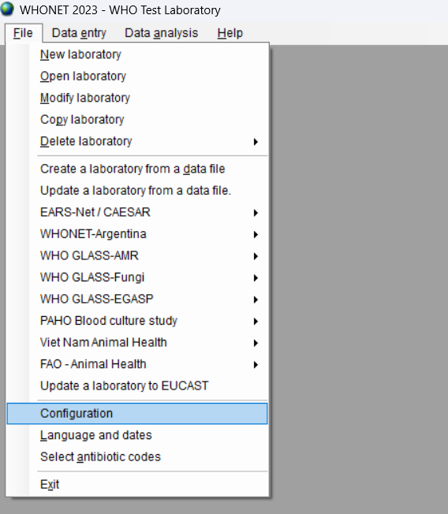
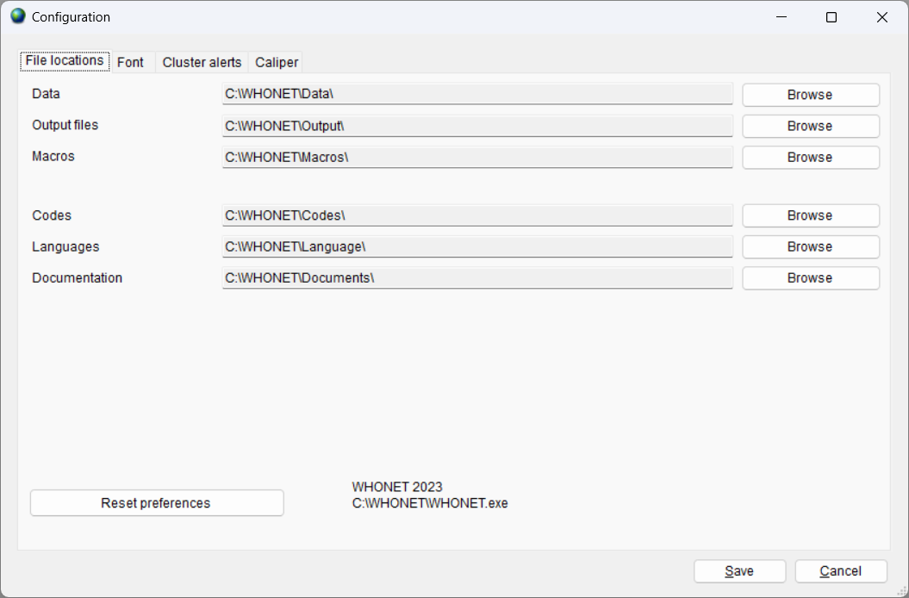
Default location for macros and reports
By default, WHONET macros are saved in the folder C:\WHONET\Macros
You can change this location through the “Configuration” option on the main “File” menu.

Slide 50
6
User-defined reports
Advantages
You define macros in Data analysis to define all of the analysis parameters you need: Analysis type, Organisms, Isolate filters, Data files, and other options.
These can be customized depending on the needs of your local and national collaborators.
Results can be viewed on the screen and shared in Excel files.
You can share your reports with other WHONET users.
Disadvantages
You must create these macros yourself.
At the present time, you can only create “Screen” and “Excel” reports.
In the future, you will also be able to create “Microsoft Word” reports.

Slide 51
6
Module 6. Data analysis – Quick analysis
A
Introduction to Quick analysis
B
WHONET Standard reports – Screen and Excel
C
WHONET Standard reports – Word
D
User-defined reports
E
DHIS2 – Brief introduction
F
WHONET Automation Tool – Brief introduction

Slide 52
Module 4. Data analysis - Overview
6
DHIS2 is a widely used web-based data analysis and visualization platform used by Ministries of Health for public health surveillance.
The new WHO GLASS platform is now based on DHIS2.
It is managed by the University of Oslo, www.dhis2.org.
The DHIS2 features of WHONET will be covered in separate training module.
B

Slide 53
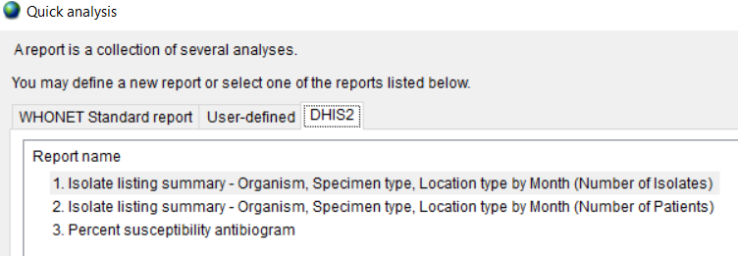
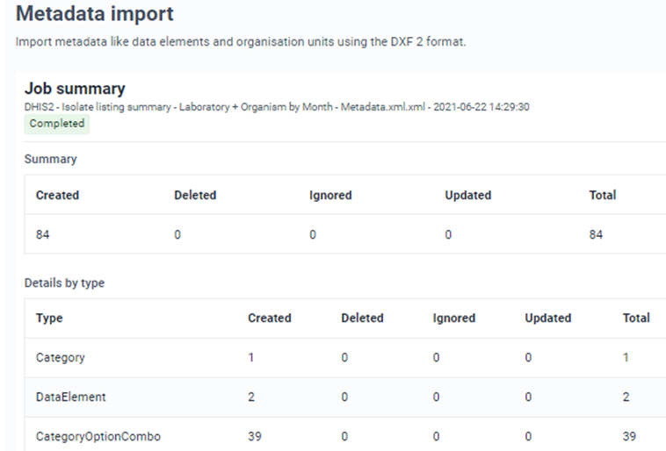
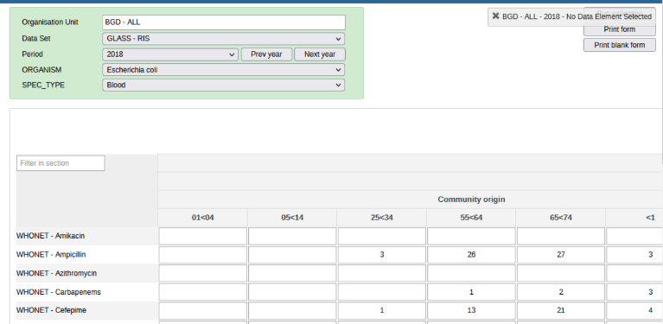
6
WHONET-DHIS2 Interoperability
Metadata, Data Set, and Event import
1. Export analysis results from WHONET
2. Import results into DHIS2
Map edited for confidentiality
3. See the results in DHIS2
4. Visualize the results in DHIS2 with maps and charts

Slide 54
6
Module 6. Data analysis – Quick analysis
A
Introduction to Quick analysis
B
WHONET Standard reports – Screen and Excel
C
WHONET Standard reports – Word
D
User-defined reports
E
DHIS2 – Brief introduction
F
WHONET Automation Tool – Brief introduction

Slide 55
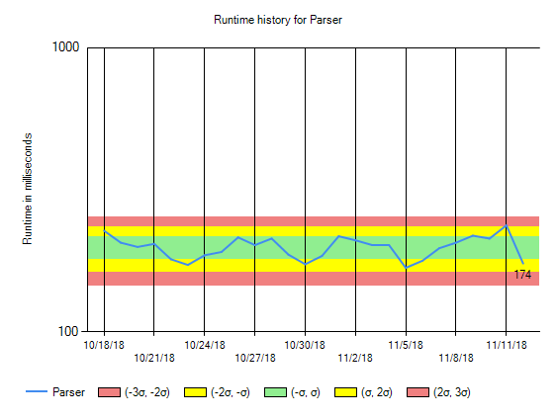
6
WHONET Automation Tool
The WHONET Automation Tool can bring automated daily, weekly, and monthly reports.
Alerts for important isolates and possible outbreaks
WHONET and BacLink alerts for data quality issues
Steps that can be automated include: BacLink, WHONET, file backups, event monitoring, and email notifications of data managers, laboratory staff, infection control teams, and national authorities.
The use of the WHONET Automation Tool will be covered in a separate training module.

Slide 56
6
Thank you for watching Module 6
Congratulations! That concludes the WHONET Training Course. Thank you for watching.

